Slide 1
Drawing Polygons

Slide 2
What’s a Polygon?
A polygon is a series of points on the screen with straight lines connecting adjacent points.
  E.g. a triangle is a set of 3 points with 3 lines connecting the points
  E.g. a quadrilateral is a set of 4 points with 4 lines connecting adjacent points
In general, if there are n points in the polygon, then there will be n lines connecting the points to make the shape

Slide 3
Example: Drawing a hexagon
Suppose we want to draw a hexagon on the screen. We must first plan where to draw the hexagon on the screen.
Sketch a copy of the screen and label the points in sequence.
Decide what might be possible coordinates for each point

Slide 4
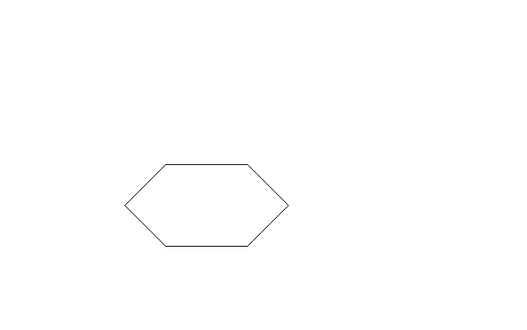
Screen
1
2
6
3
5
4

Slide 5
Screen
1
(100,100)
2
(200,100)
6
(50,150)
3
(250,150)
5
(100,200)
4
(200,200)

Slide 6
The Pygame Polygon Command:
pygame.draw.polygon(screen, color, coords, width)
screen is the screen you want to draw on
color is the color your polygon will be drawn in
coords is a list of points on the screen. Points are pairs of numbers of the form (x,y)
width is the width of the line. A width of 0 means the polygon is filled.

Slide 7
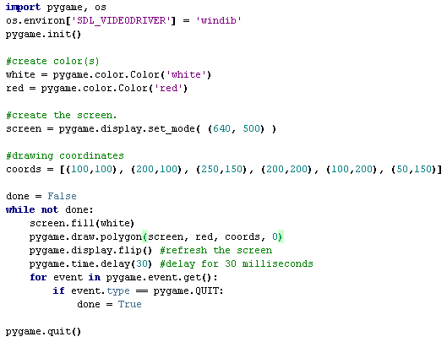
Python Example

Slide 8
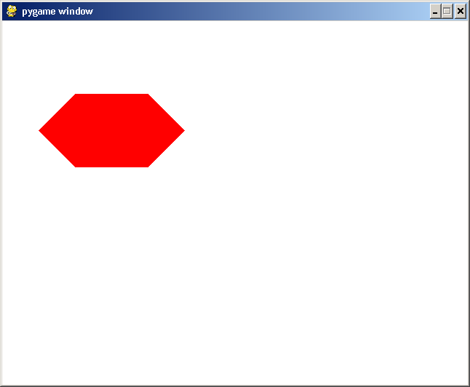
Python Output

